Slide 1
How Generative AI Is Transforming the Search Marketing World
March 7, 2023
March 7, 2023
Notes:
Add the shopping cart and logo

Slide 2
About NetElixir
Generative AI and Search
The Future of Search Marketing
Winning in the “New” Search Ad Landscape

Slide 3
About NetElixir

Slide 4
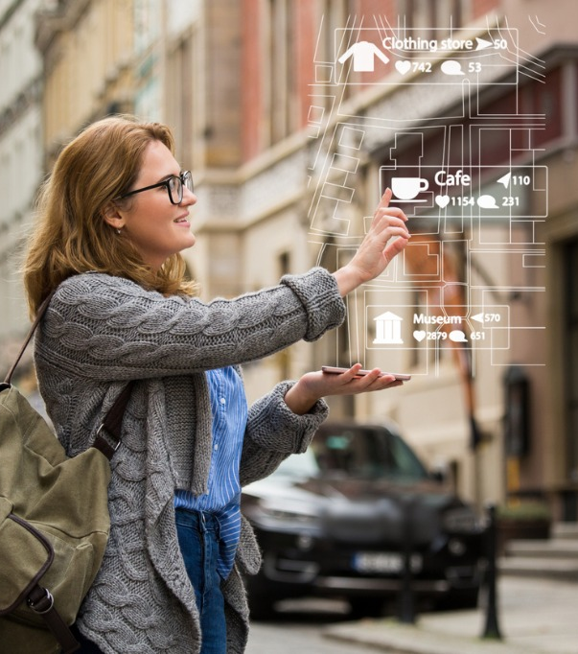
The NetElixir Difference
Digital Marketing Specialists
with 19+ Years Experience
7,000,000+ Hours Invested in Skill and Strategy Expertise
13+ years of International
Search Marketing Experience
India Business Center
Proprietary AI-Powered Marketing Platform
LXRInsights
Member of the Google Leadership Circle
27 out of 7,761 Agencies in the US
Certified Minority Business Enterprise
National Minority Supplier Development Council
UDAAN Trust Flight Foundation

Slide 5
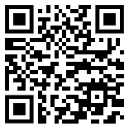
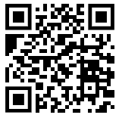
Give the
Gift of a Smile
The Udaan Trust - Flight Foundation is now on AmazonSmile!
Find us on
Donate directly

Slide 6
About
Presented by
Innovation Fellow:
Lang Center of Entrepreneurship, Columbia Business School
Guest Lecturer:
Johnson School of Management, Cornell University
City University of New York, Baruch
Indian School of Business
Udayan Bose
Founder & CEO
NetElixir
linkedin.com/in/netelixirudayanbose/
udayan@netelixir.com

Slide 7
How Generative AI
Is Transforming Search

Slide 8
Generative AI Explained, Simply

Slide 9
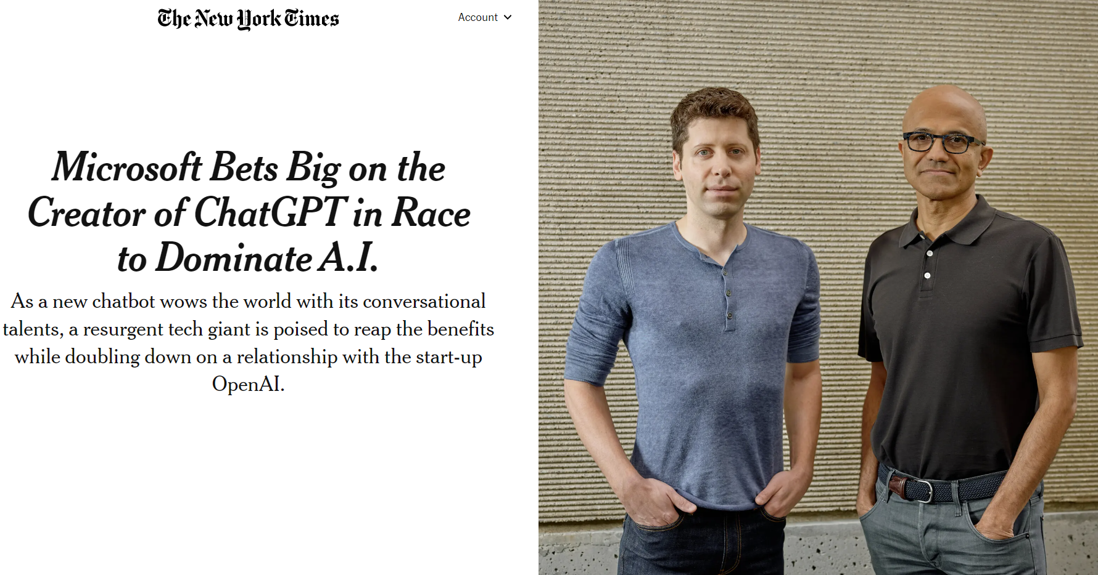

Slide 10
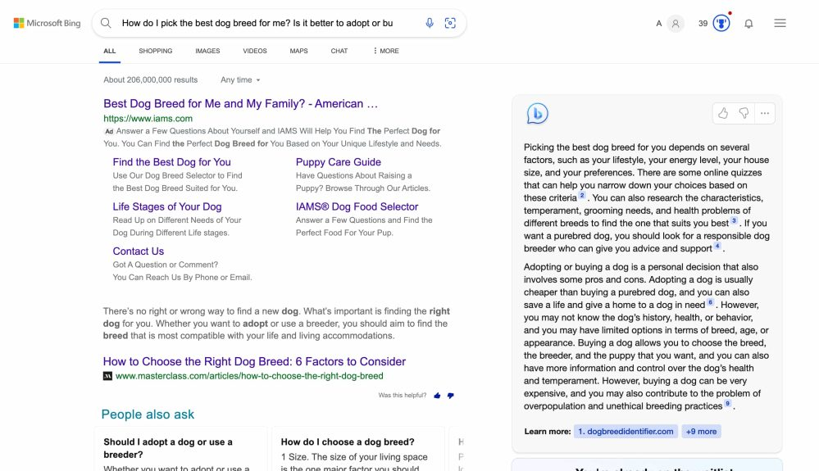
Additional Opportunity for Brands to build deeper Zero Moment of Truth (ZMOT) engagement with potential customers.
Ad Budget Shift to the “New Bing”?

Slide 11
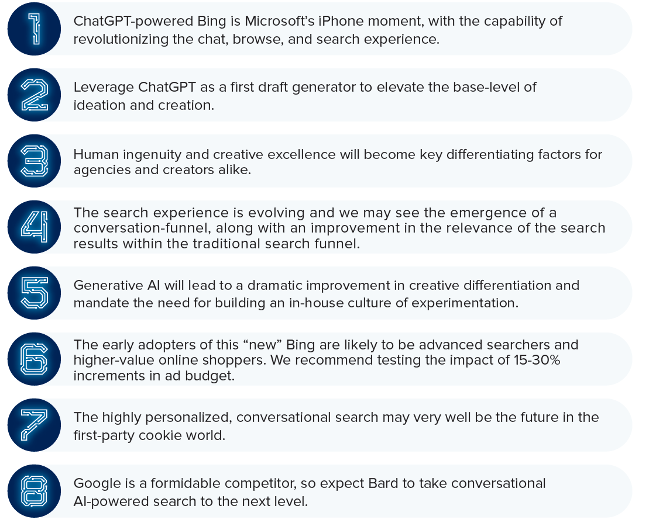
How ChatGPT is Going To Transform Search And What You Should Know About It

Slide 12
Recommended Reading
Generative AI: A Creative New World by Sonya Hung and Pat Grady, Sequoia. https://www.sequoiacap.com/article/generative-ai-a-creative-new-world/
Planning for AGI and Beyond by Sam Altman, OpenAI. https://openai.com/blog/planning-for-agi-and-beyond
How Generative AI is disrupting search, https://www.netelixir.com/chatgpt-conversation/

Slide 13
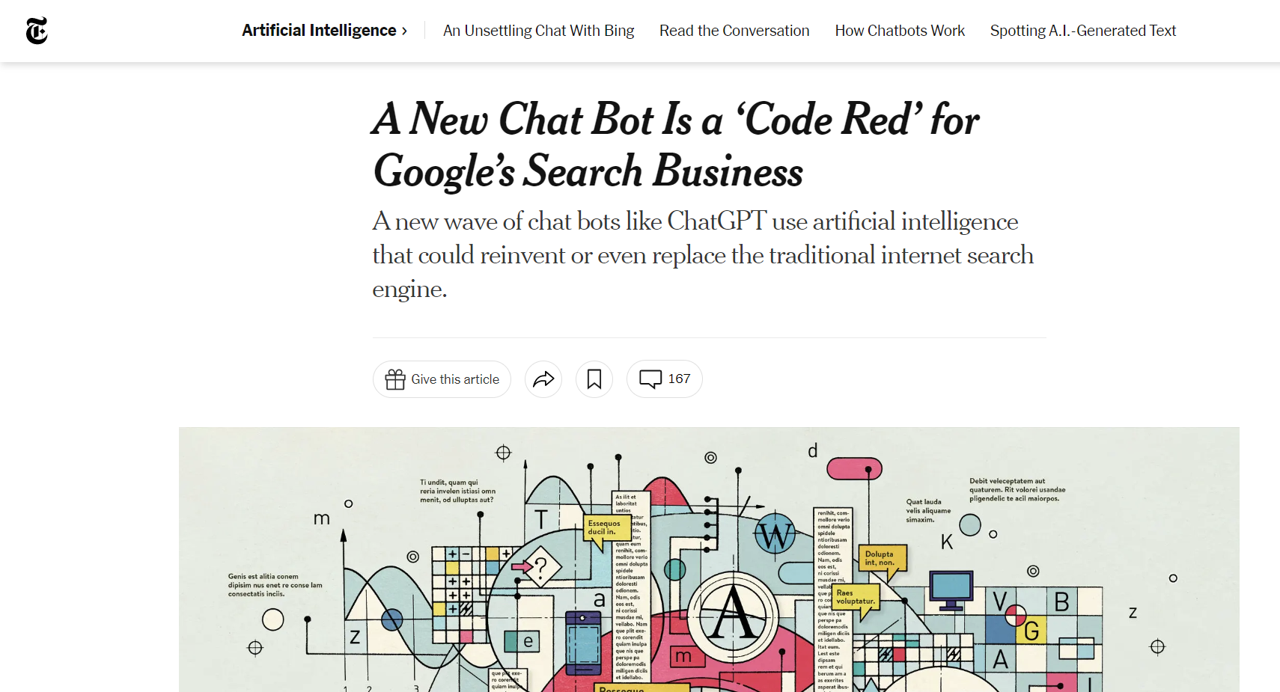
Challenges for Google

Slide 15
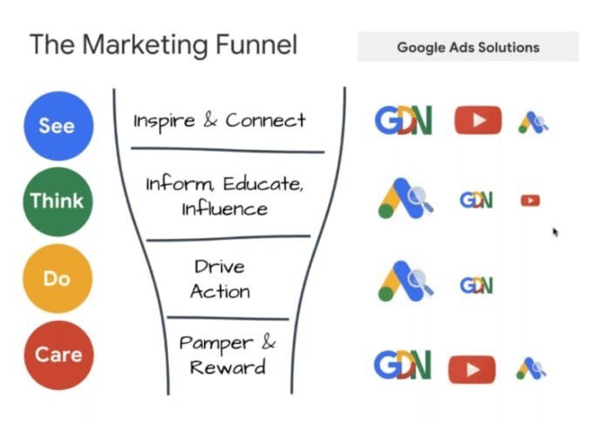
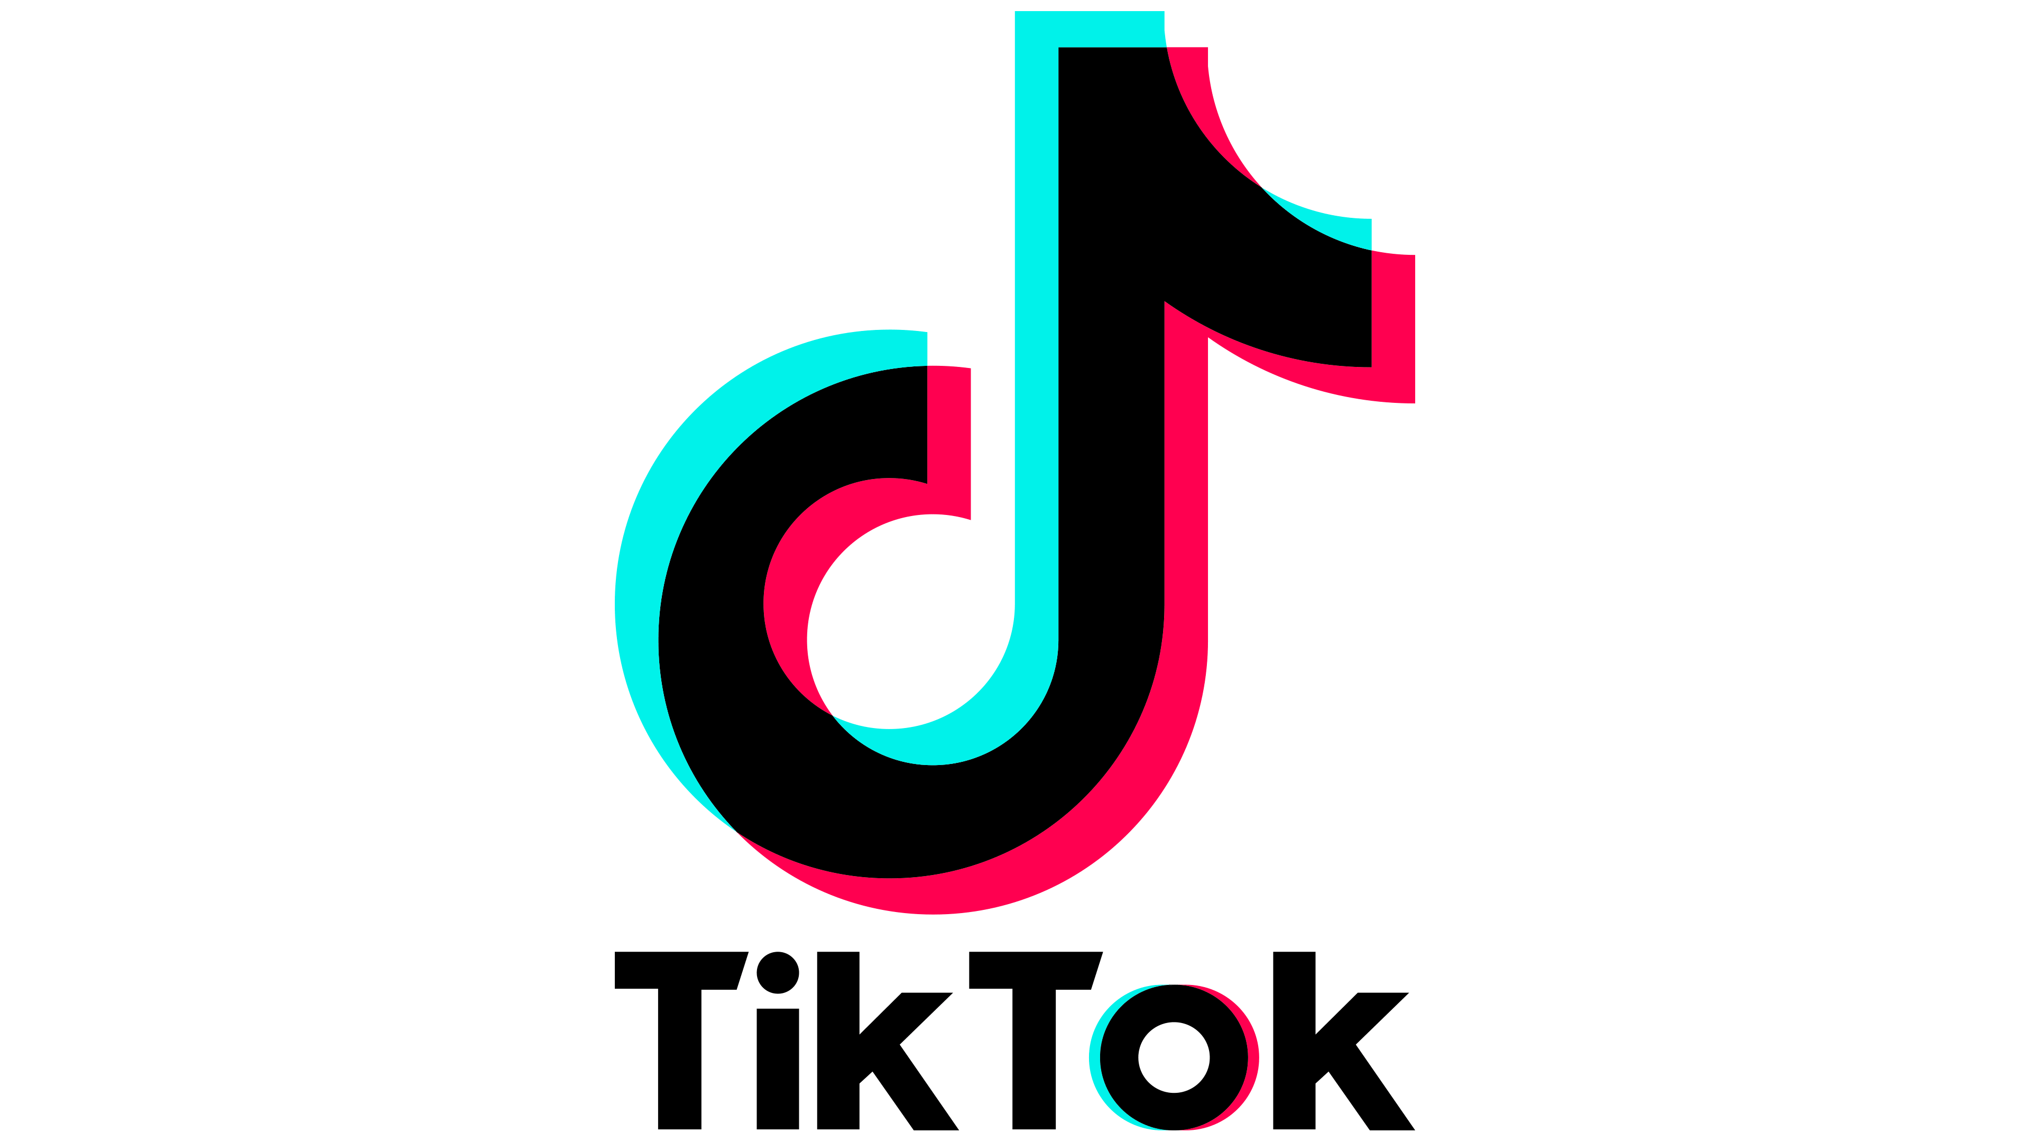
Google is getting pushed to the middle of the funnel

Slide 16
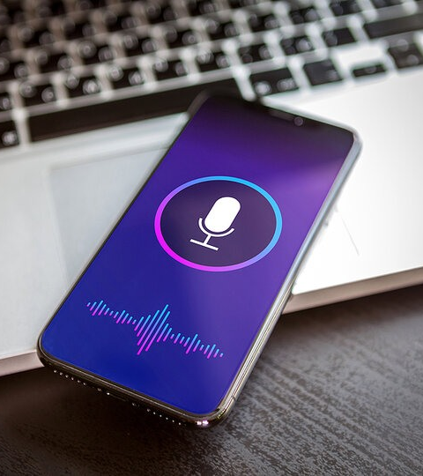
Emergence of a New Conversational Search Funnel?

Slide 17
The Future of Search Marketing
Cookieless World. Google Ad Gets AI’d.

Slide 18
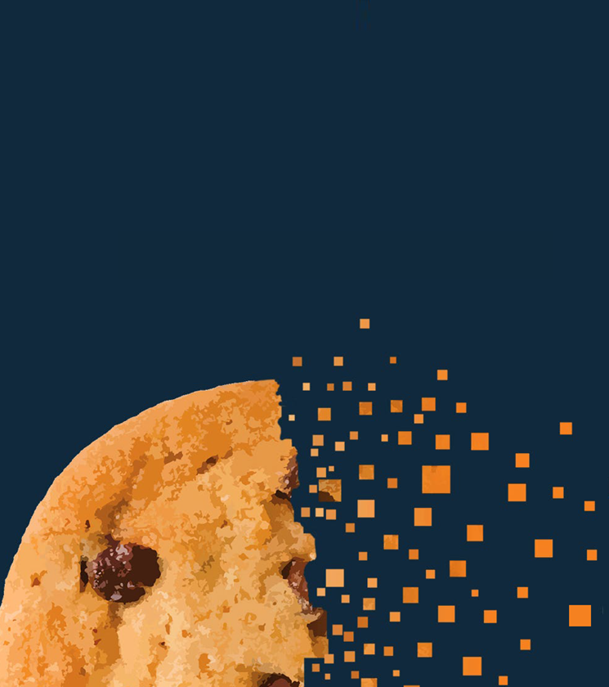
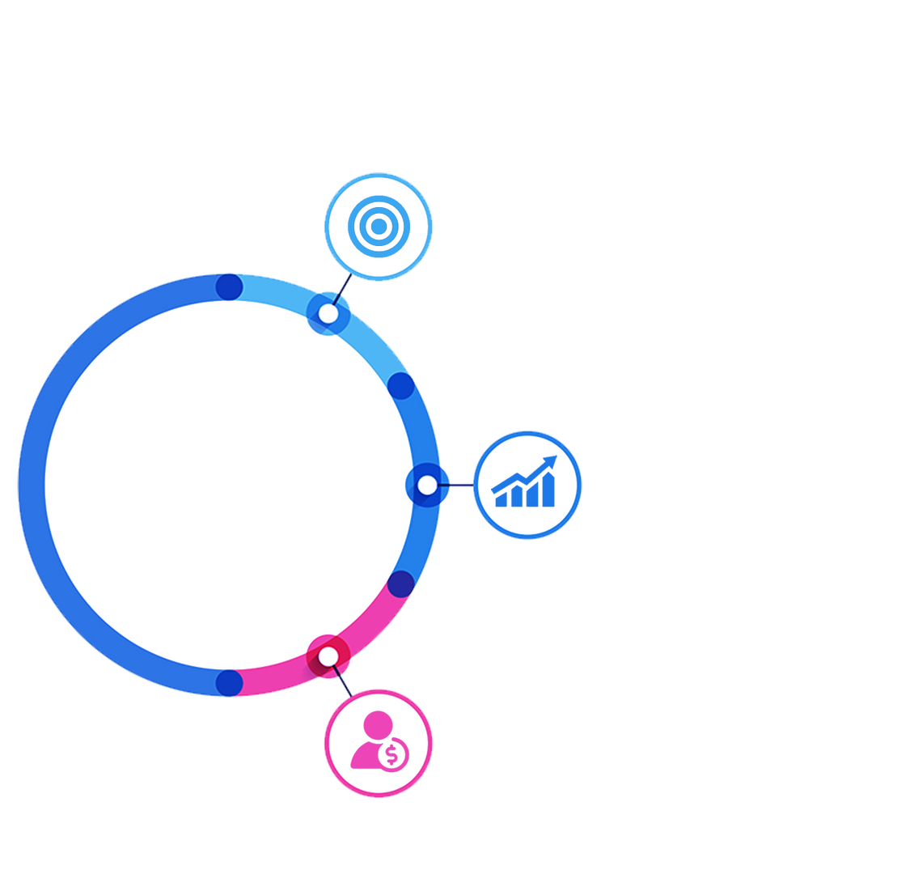
Google’s Decision to Deprecate 3P Cookies on Chrome Browser Will Disrupt the Digital Marketing Ecosystem
Addressability
Targeting Precision
and Personalization
The Digital Advertising Building Blocks that will be Affected by the 3P Cookie Deprecation
Measurement
Accurate Reporting and
Campaign Optimization
Attribution
The Path Between Ad
Interaction and Conversion

Slide 19
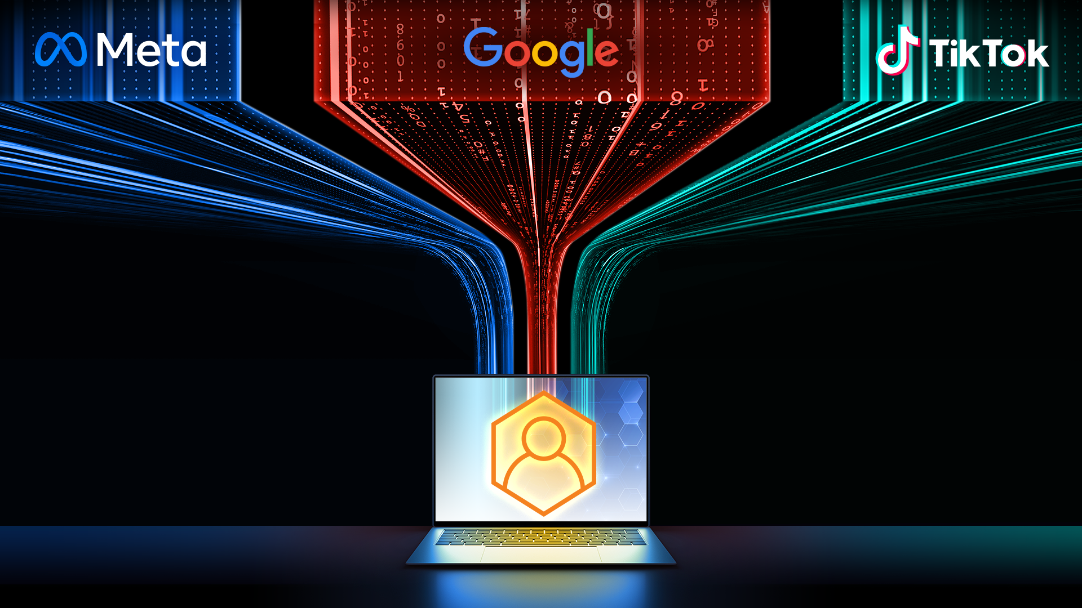
Deprecation of 3P Cookies will lead to a Highly Fragmented Digital Marketing Landscape.
Deep Expertise & Smart Technology will be needed to choose the right channels and win in the chosen channels
2030

Slide 20
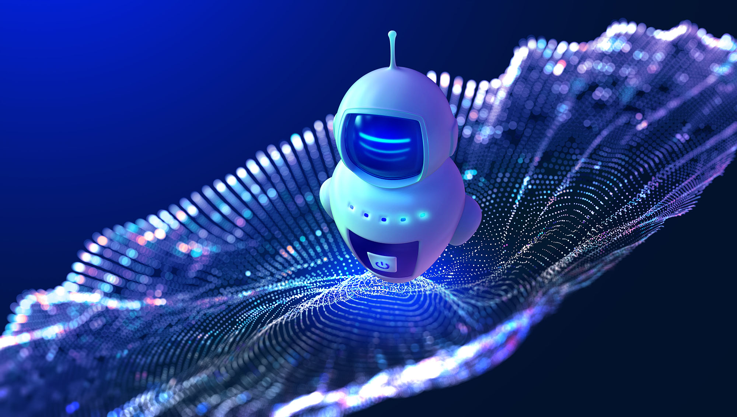
AI

Slide 22
What can You Control in the “new” Google Ads?
Audience
Segmentation
Iterative Experimentation leading to creation of custom optimization strategies
Do you know the recipe of ingredients for
Achieving your goals?
Creative
Differentiation

Slide 23
Winning in the
“New” Search Ad Landscape

Slide 24
How Digital Marketers Can
Win in 2023 and Beyond?
Classical search agency marketing model is dead.
We believe that the future will be led by strong AI/ML growth marketing partners who act as consultants, who can empower inhouse teams, to scale your business.
This AI-powered wave of “New Digital Marketing” is very different and more powerful than previous digital waves. The landscape has changed quickly in the wake of ChatGPT launch, so if you’re not ready, your brand will quickly lose traction.
You need strategic marketing partners who can combine the best of AI and human ingenuity to future-proof your business.

Slide 25
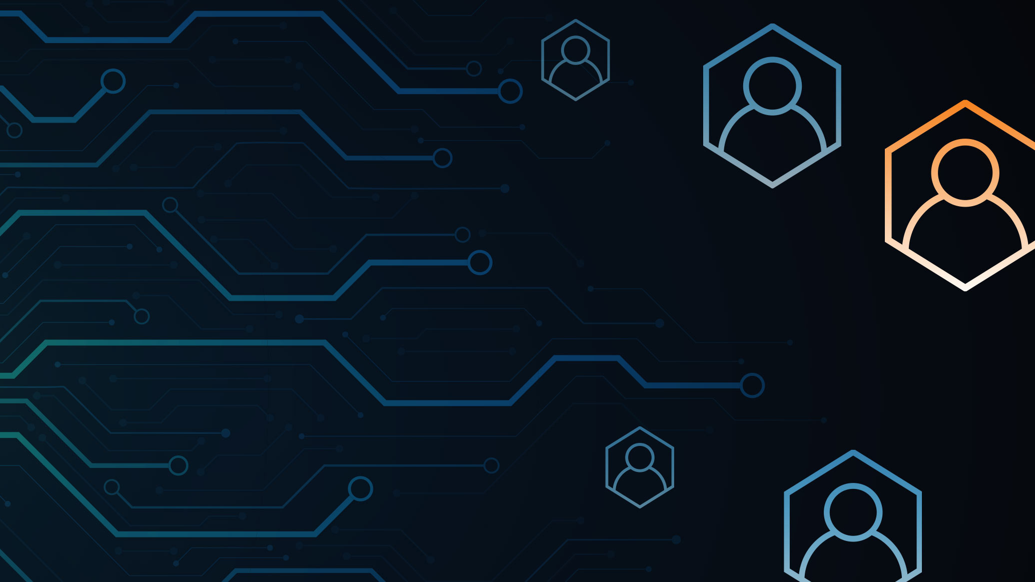
AI + Expert Consulting
The Power of Machine Learning with a Human Touch

Slide 27
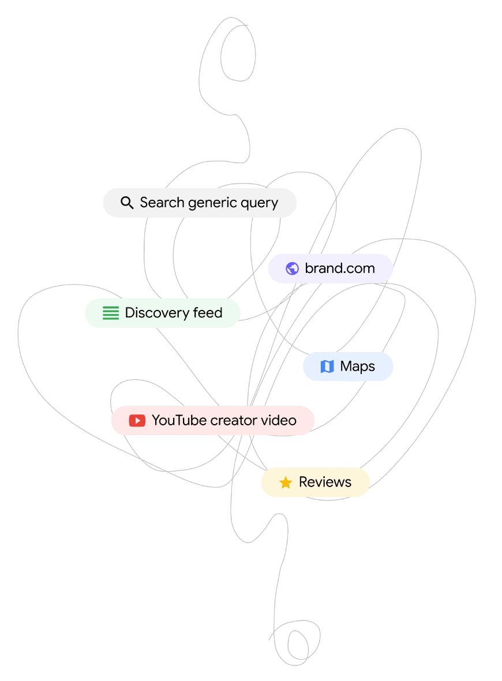
The Formula for a Successful PMax Campaign
Feed the Google AI High Quality Data (Audience, Campaign Set Up, Creatives), Set Right Goals, and Continuously Test to Gain Actionable Insights… Repeat!
Use NetElixir’s AI-powered Marketing Platform, LXRInsights, to Find and Add High-Value Audiences
Use AI
Apply NetElixir’s Custom PMax Campaign Frameworks and High Quality Ad Creatives to Get the Campaigns Off to a Strong Start
Apply PMax Frameworks
Conduct Tests/Experiments and Use Insights derived from the Insights and Explanations Tab to Continuously Improve the PMax Campaign
Test & Learn

Slide 29
How NetElixir has driven predictable Performance Lift for clients from “New” Google & Meta Ads?
Our Proprietary AI Marketing Platform, LXRInsights, for the “New” Google and Meta Ads (Inhouse Product Innovation Lab focused on AI Innovation).
Proven Performance Optimization Strategies Retail, DTC and B2B eCommerce Marketers (7MM+ Hours of eCommerce Marketing Experience).
Development of custom optimization strategies through the process of iterative experimentation (Culture of Experimentation).
Dedicated Premier Agency Support from Google, Bing, Meta, TikTok (Google Agency Leadership Circle).

Slide 30
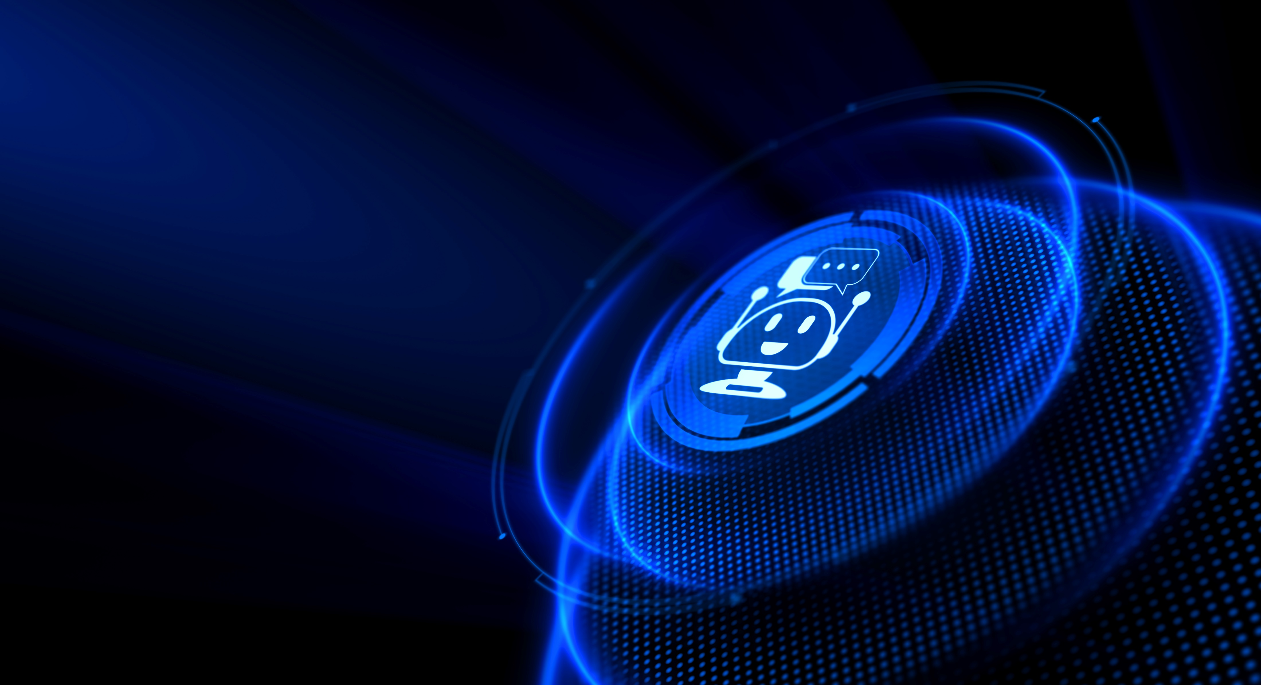
Are you using AI-Powered Strategies to predictably grow your Google & Meta Ads?
Get A Future-Ready Assessment
Identify opportunities to leverage AI-modules that drive incremental growth for Google Ads and Meta Ads
Free Scorecard
Future Ready Assessment
Ongoing Strategic Consulting
For Right Now
For The Next 45 Days
For Long-Term Growth

Slide 31
Thank You
Interested in ChatGPT Application Ideas for Search Marketing?
Email Me
udayan@netelixir.com

